Slide 1
levi9 CODE9 2021
Azure SQL databse
Ruzica Kersoja
Novi Sad, 24.05.2021

Slide 2
Agenda Slide
01
03
About Me
Demonstration in Azure
02
04
SQL DB intro
Questions and end slides

Slide 3
01. About me
Ruzica Kresoja

Slide 4
01 SQL Database intro
Relation database management system (RDMBS)
For accessing we are using SQL Management studio where we are using T-SQL
SQL Server Architecture
- Database Engine (Database Engine, Relational Engine)
SQLOS
SQL Server Services and Tools
SSIS (SQL Server Data Quality Services) (example: for loading csv data into databse)
SSRS (SQL Server Reporting Service)
SSMS (SQL Server Mangement Studio)
Etc...
Notes:
https://www.sqlservertutorial.net/getting-started/what-is-sql-server/ - Pogledaj ovde sta ti odgovara pa ako zelis prepravi slajd.

Slide 5
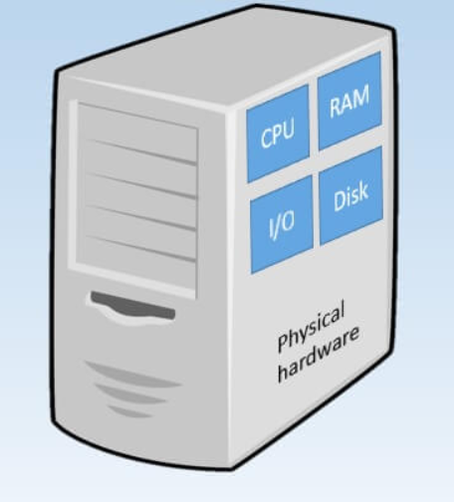
Storing database – Physical hardware
At he beginning database was storing of physical servers
Issues:
How to add more memory?
How to add more processors cores?
How to replicate server?

Slide 6
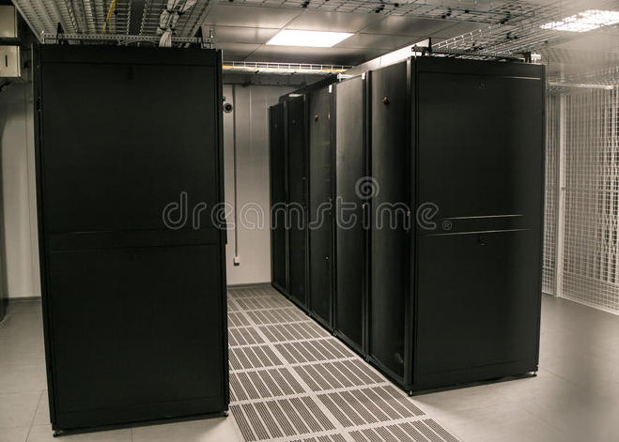
Storing database – Storages and virtual machines
Advantages:
Add new memory
Adding more processors
Creating new VM
Disadvantages:
Limited with structure of storage
What about disasters?
Power supply costs?

Slide 7
Storing database – AZURE
Container data center all around the world. Offer hudgde number of service, functionalities...
Unlimited resources
SQL Server on Azure VMs:
Virtual Machine resource is needed
SQL Database should be installed
Paying license
Maintenance of VM and Database
On premise migration is recommended
SQL Service as Service:
No VM
Underlying structure is maintained by Azure
On premise migration is not recommended

Slide 8
02 Demonstration in AZURE
Staring from requirement:
Survey have time frame for which is open. After time expires survey is automatically closed or user which created can do that before time expires
Survey contains questions and offered unswears
Participant needs to fill in next mandatory parameters before log into application: FirstName, LastName, Email and Password
- Creator of survey should have possibility to follow unswears on front end

Slide 9
Database model - recommendations
Naming convention for creating database object should exist
- Tables names must end with s
PimaryKeys: PK_<TableName>
Foreign Keys: FK_<TableName>_<TableName2>
Unique Indexes/Constraints: UN_<TableName>_<Columns>
Use schemas for grouping database objects
Use foreign key constraints to protect your data from garbage
Add auto-increment identity in most cases. Only on static table in not needed.
In every table add columns for informations who created, updated row and dates for actions.
Build tables to suport milion of rows.
Decuple tables entries if it is possible

Slide 10
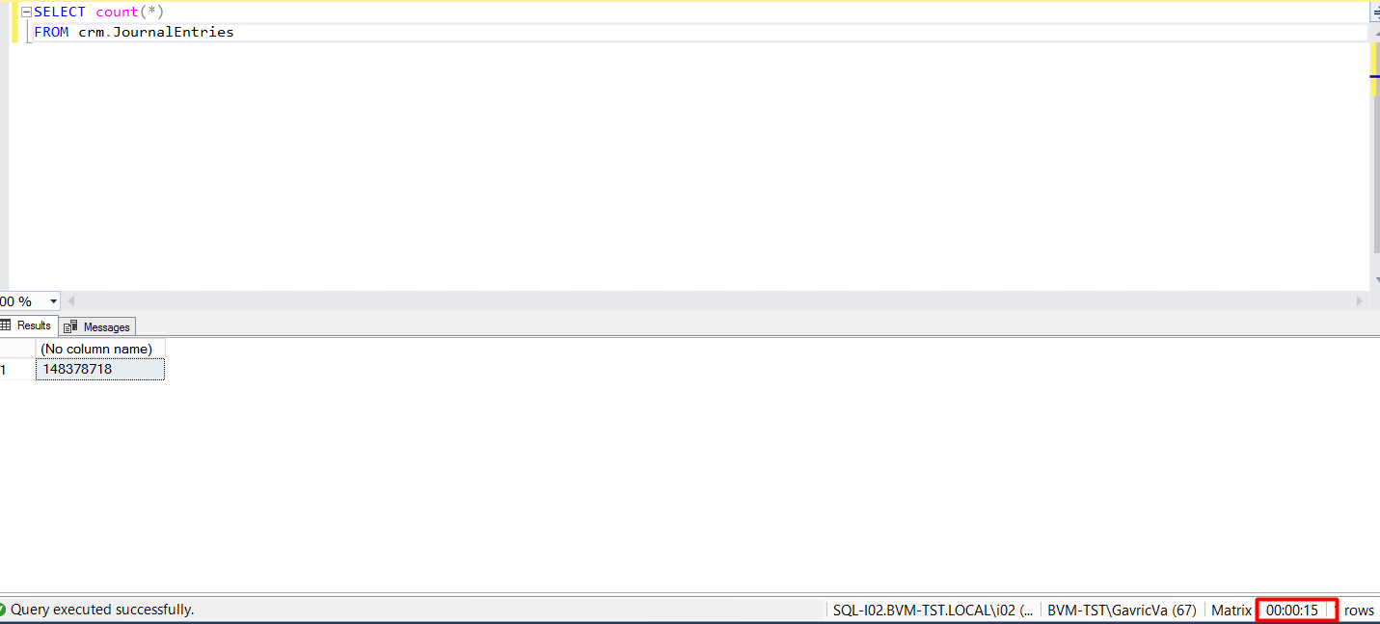
Examples of bad data models
Bank system have customers which have data (First Name, Last Name, JMBG etc...)
Every customer have accounts and payments
We are determining name journal for every change on customer data or on payment
As result we have next:
15 seconds only for counts
For solving, indexes should be added
Use SOLID principles and patterns
Database should be only used for tables

Slide 11
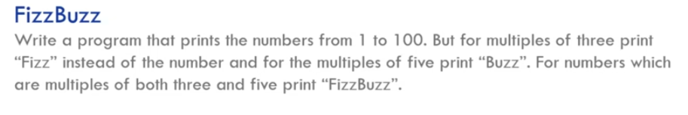
Think about
How this can be implemented without iterator and switch case statements?

Slide 12
Questions

Slide 13
Thank you
Serbia / Novi sad
Levi9 Global Sourcing Balkan d.o.o.
Novi Sad Offices
Trifkovicev trg 6
21000 Novi Sad, Serbia

